Slide 1
Data Movement Is All You Need: A Case Study on Optimizing Transformers [1]
I. Background and challenges
III. Results
Signiﬁcant performance improvements
Transformers are becoming the dominant task for machine learning.
The transformer architecture consists of two main components: multi-head attention (MHA) and a feed-forward network.
Training has become memory-bound; Data movement is the key bottleneck when training transformers.
Existing frameworks use suboptimal data layouts.
Existing implementations do not efﬁciently utilize GPUs.
Reduce data movement overheads by up to 22.91% over existing implementations
Achieve at least 1.08 × performance improvements over specialized libraries
1.30 × over general-purpose frameworks
Model | Saving
Robustly training BERT [3] | $85,000
GPT-3 transformer [4] | $3,600,000 (training cost $12M) [5]
II. Methods (a summary)
Globally optimizing data movement
Construct a dataﬂow graph for the training process and use it to identify operator dependency patterns and data volume.
Identify opportunities for data movement reduction to guide optimization using the dataflow graph.
Maximize data reuse using fusion.
Select performant data layouts for normalization and tensor contraction operators.
Produce an optimized end-to-end implementation based on the above steps.
The paper uses particular transformer models as examples, but its methods are applicable to other DNN models and architectures.
[1] https://arxiv.org/abs/2007.00072
[2] https://github.com/spcl/substation
[3] https://arxiv.org/abs/1907.11692
[4] https://arxiv.org/abs/2005.14165
[5] https://venturebeat.com/ai/ai-machine-learning-openai-gpt-3-size-isnt-everything/

Slide 2
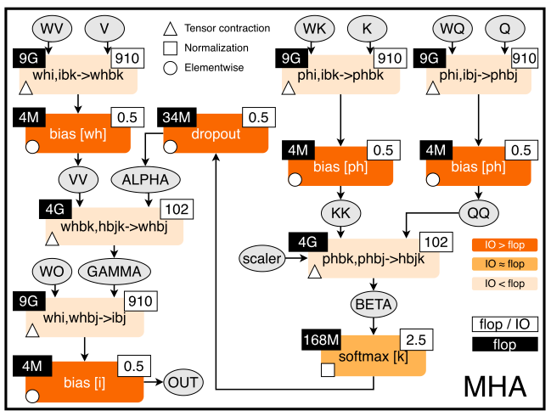
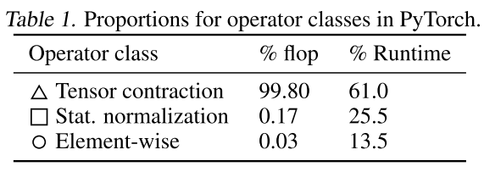
Data Movement Is All You Need: A Case Study on Optimizing Transformers [1]
II. Methods
1. Optimizing transformers
Operator classes
* Construct a dataﬂow graph for training and analyze the
computation to identify common operator classes.
* Develop a generic recipe for optimizing training using dataﬂow analyses.
* Using the recipe, systematically explore performance of operators and the beneﬁts of different optimizations.
Dataflow and optimizer classification
Tensor Contractions: △ These are matrix-matrix multiplications (MMMs).
Statistical Normalizations: ⬜ These are operators such as softmax and layer normalization.
Element-wise Operators ○ These are the remaining operators: biases, dropout, activations, and residual connections.
Figure 1. Input code and stateful dataﬂow multigraph (SDFG) for Multi-Head Attention. Throughout the paper, if not stated otherwise, the values are given for the following set of parameters: P = W = 64, H = 16, I = P ⋅ H = 1024, B = 8, J = K = 512. P/W: key/value projection size; H: # heads; I: embedding size; B: batch size; J/K: input/output sequence length.
* flop: ﬂoating point operations

Slide 3
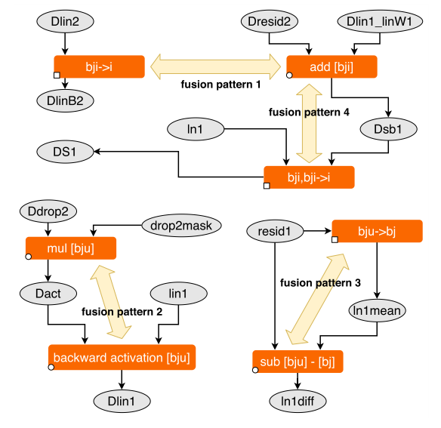
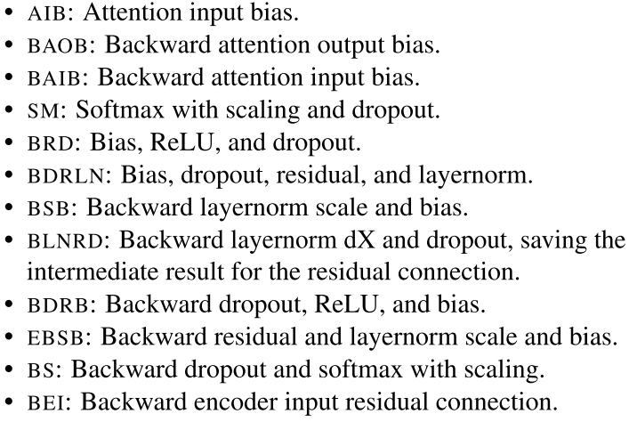
Data Movement Is All You Need: A Case Study on Optimizing Transformers [1]
III. Methods
2. Fusion
Step 1: two operators can be fused if their iteration space implementations are compatible: they are either the same or the only difference is that one operator performs a reduction.
Fusion is a major opportunity for promoting data reuse. It puts multiple operators together to reuse the input/output data.
Step2: When a fusion opportunity is detected, decide: 1, if fewer kernel launches by merging iteration spaces; 2, if less data movement by avoiding loads and stores between operators.
Fusion consists of two steps: step 1. detecting which operations can be fused, step 2. deciding whether it is beneﬁcial to fuse them.
Perform fusion using the SDFG, two adjacent operators are fused until either a reduction dimension or iteration space changes.
Each fused operator is implemented as a CUDA kernel specialized for a speciﬁc data layout.

Slide 4
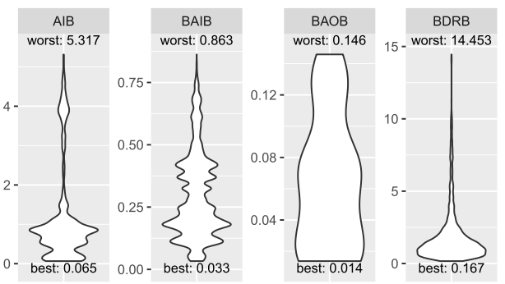
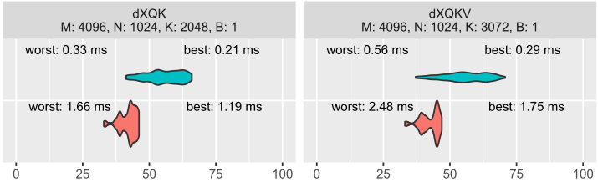
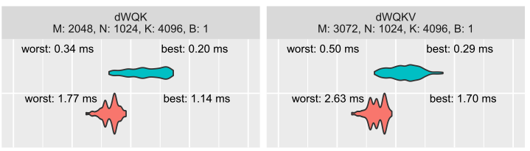
Data Movement Is All You Need: A Case Study on Optimizing Transformers [1]
III. Solutions
3. Data layout selection
For each operator (tensor contractions and fused operators), benchmark every feasible data layout (all equivalent permutations), as well as varying other parameters depending on the speciﬁc operator.
Data layout selection is particularly impactful for normalization and tensor contraction operators, where it provides opportunities for vectorization and different tiling strategies.
Tensor Contractions
Violin plots: the width represents the relative number of conﬁgurations with the same runtime.
Fused Operators
The most noticeable performance improvement is made by layouts that enable vectorized memory access, showing that the main performance limitation is the amount of moved data. The second notable category are layouts with the same reduce and vector dimensions.
Note that, the performances of Tensor contraction performance are shown in as % values.

Slide 5
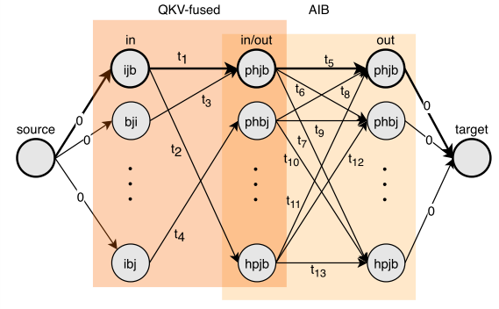
Data Movement Is All You Need: A Case Study on Optimizing Transformers [1]
III. Solutions
4. End-to-end optimization
Automatic conﬁguration selection algorithm:
Example:
Add a node to the graph for each input and output data layout of the operator.
Add an edge from the input to the output layout, weighted with the minimum runtime of any conﬁguration with that layout.
Run a single-source shortest-path (SSSP) algorithm from the input to the output in the graph, and the resulting path is the ﬁnal conﬁguration.
Because the graph is a directed acyclic graph (DAG) and the number of feasible input/output conﬁgurations for each operator is small, so SSSP takes linear time asymptotically and seconds for BERT.
QKV-fused: three input tensors queries (q), keys (k), and values (v) fused.
AIB: Attention input bias.

